Slide 1
Inspiring Greatness
At Osceola Fundamental High School

Slide 2
What is CTED?!
Center for Technology, Entertainment, and Design
Career, Technology, Industry Focused Career Pathways
Preparing students for the world of work

Slide 3
Industry Aligned Pathways, Courses & Opportunities
Digital Design
Digital Media Technology
Sports Marketing
Entrepreneurship
Digital Information Technology
Web App Dev & Programming
On the Job Training (OJT)
AP Comp Science
Job Shadowing
Internships
Travel Field Trips
Future Business Leaders of America
National Technical Honors Society

Slide 4
Digital Information Technology
MS Word, Excel, PowerPoint
Career Exploration
Resumes/Cover Letters
Business Documents
Soft Skills
Professional Dress
A little bit of:
Web design
Graphic Design
Networking/Computer Science
Entrepreneurship
PREPARING
STUDENTS
FOR THE WORLD OF WORK WITH HIRABLE SKILLS!
FOR CAREERS
THAT DON’T
EXIST YET!

Slide 5
Digital Information Technology
Meets Graduation Requirements:
Practical/Fine Arts
Online
Notes:
If your student hasn’t taken DIT yet, we highly recommend registering for it as it will help them in all of their other courses. This is the course for everyone.

Slide 6
Web Application Development & Programming Pathway *
CLASS ORDER:
DIT
Foundations of Programming
Procedural Programming
Object-Oriented Programming Fundamentals
Industry Certifications
Python
Javascript
HTML/CSS
Notes:
Throughout this pathway you will learn computer coding in python, HTML, CSS and JavaScript. Along the way you will create interactive webpages and write computer games using pygame. Certifications include introduction to programming using Python, HTML/CSS and JavaScript.

Slide 7
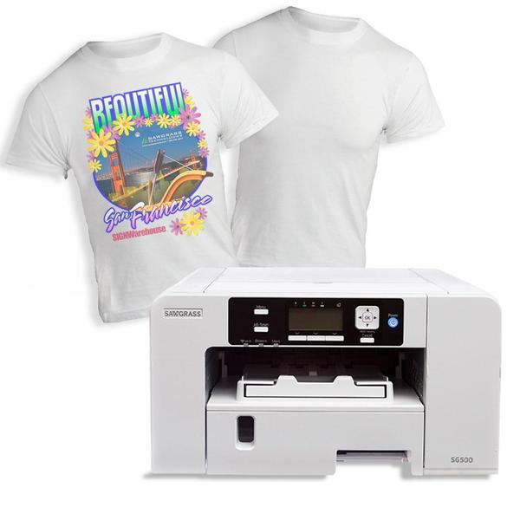
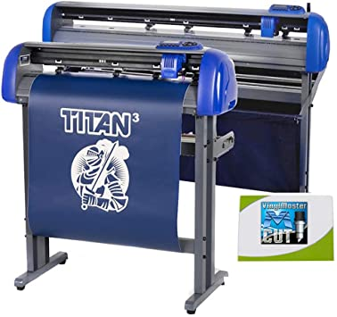
Digital Design Pathway
Course Order:
DIT
Digital Design 1
Digital Design 2
Digital Design 3
Adobe Certifications in:
InDesign
Illustrator
Photoshop
Logo/Branding
Illustrations
Publications
Commercial Art
NEW: Print Production!
Notes:
Digital Design Pathway focuses on learning Adobe InDesign and Photoshop the first year with Illustrator the 2nd year. Digital Design three learns Premier Pro & students embark on a personalized learning project to explore additional design and coding products of their choice. Throughout the pathway students learn how to hone their creativity to create professional logos, branding, and marketing materials and also dabble in Photography, illustrations, surrealism, and more.

Slide 8
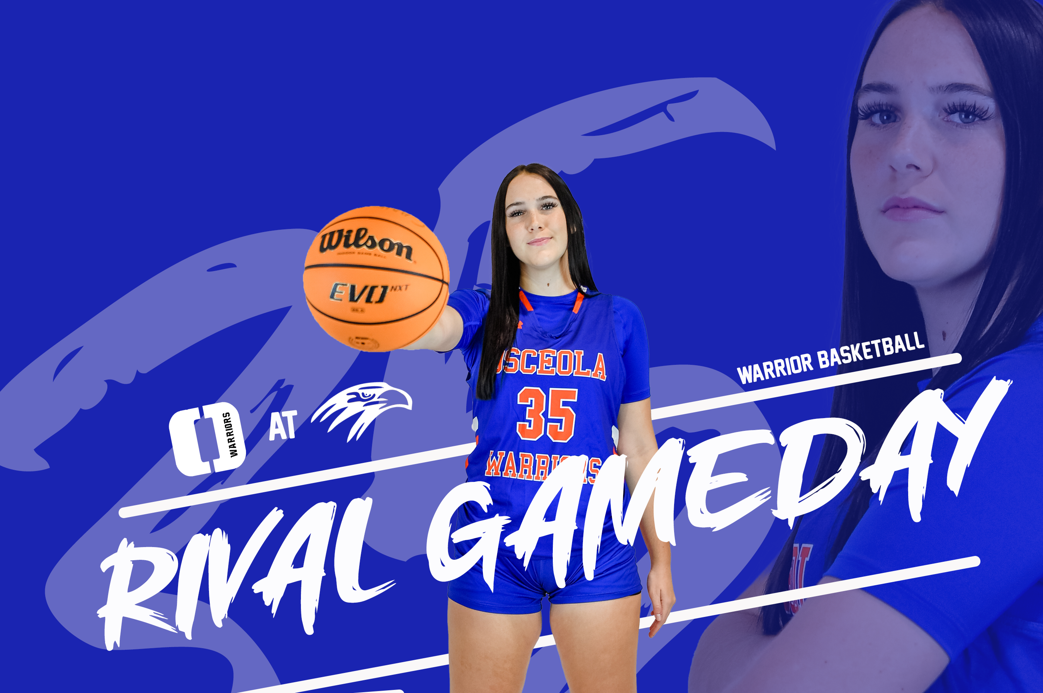
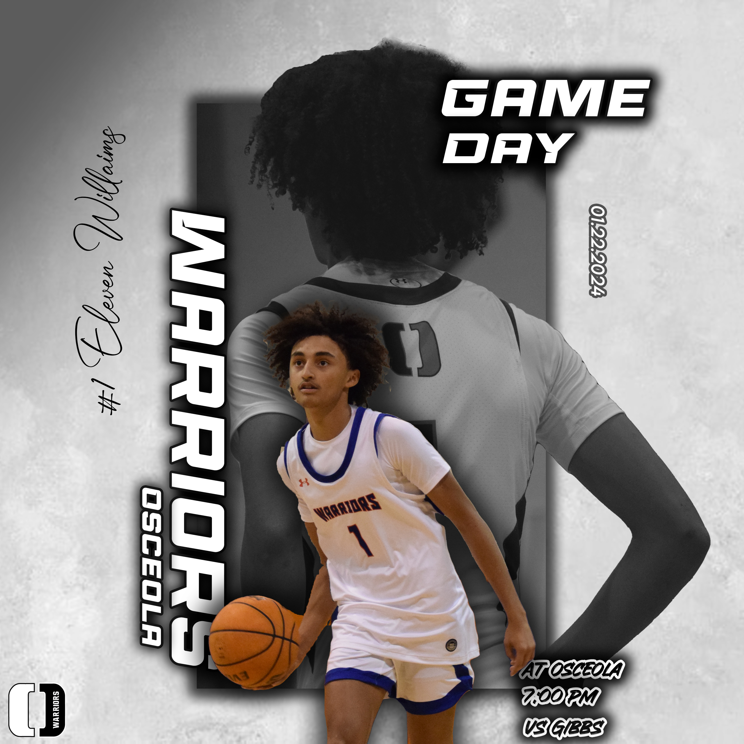
Sports Marketing Pathway
COURSE ORDER:
DIT
Sports, Recreation, and Entertainment Essentials
Sports, Recreation, and Entertainment Applications
Sports, Recreation, and Entertainment Management
Works with our school to promote events and games using the marketing and management skills learned throughout the pathway
Notes:
Throughout the Sports Marketing Pathway students learn how to market sporting events, music & entertainment venues, and motion pictures. Students get real-world, hands-on experience marketing and promoting school events.

Slide 9
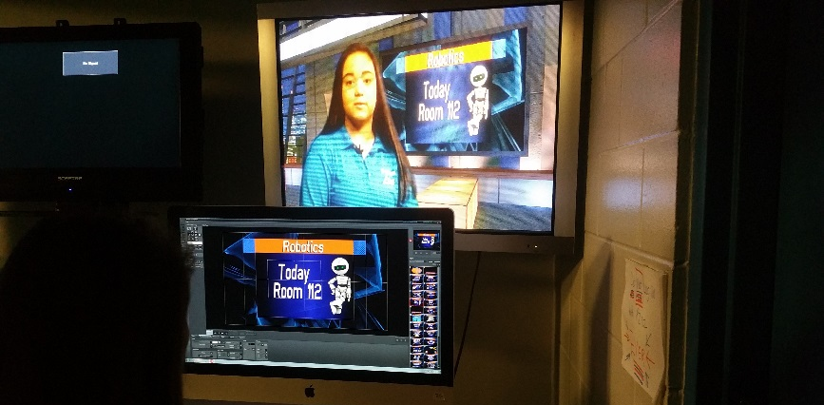
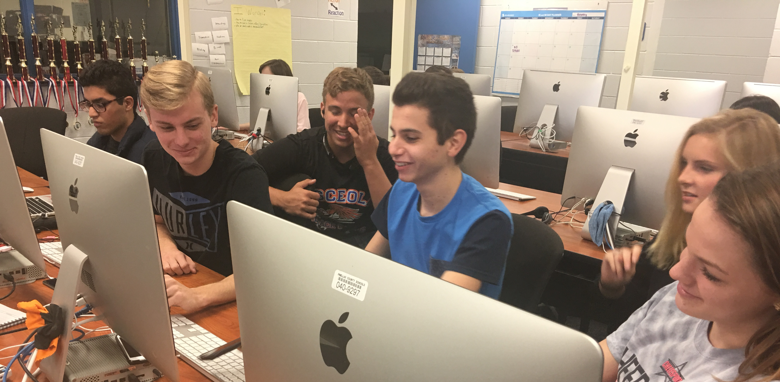
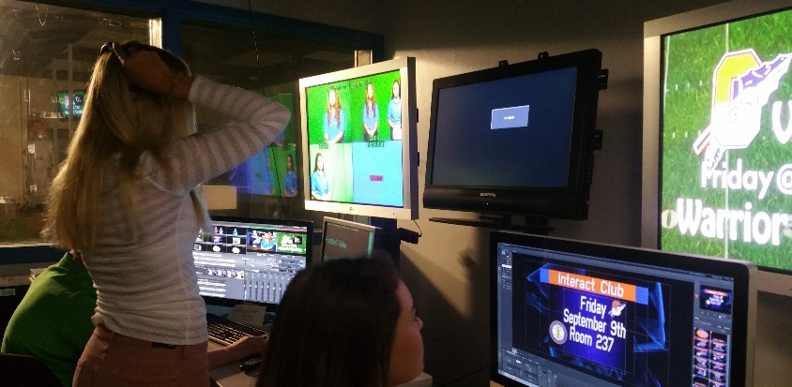
Digital Media Technology
COURSES
Digital Media Fundamentals
Digital Media Production Systems
Digital Media Delivery Systems
Advanced Digital Media Systems
Live Morning Show – O-Town Live
Notes:
Students learn the art of producing, editing and directing. Whether your student is a budding filmmaker or a storytelling enthusiast, our hands-on classes will equip them with the skills needed to bring their vision to life. We also offer our Live Morning Show – O-Town Live.

Slide 10
Digital Media Technology
Certifications
Adobe Premiere Pro
Adobe After Effects
Adobe Photoshop

Slide 11
Business Management & Analysis (Entrepreneurship)
INDUSTRY CERTIFICATIONS
COURSE ORDER
DIT
Business and Entrepreneurial Principles
Management and Human Resources
Legal Aspects of Business
Notes:
Business and Entrepreneurial Principles: This course is designed to provide an introduction to business organization, management and Entrepreneurial principles. We will touch on market economy, market need, marketing your business, the marketing mix, developing a business plan, ownership, location, ethics, corporate social responsibility, finances, management, HR, and risk management. We also offer a certification.

Slide 12
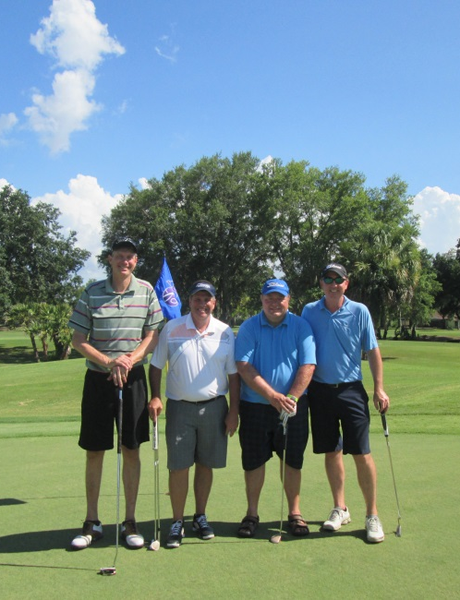
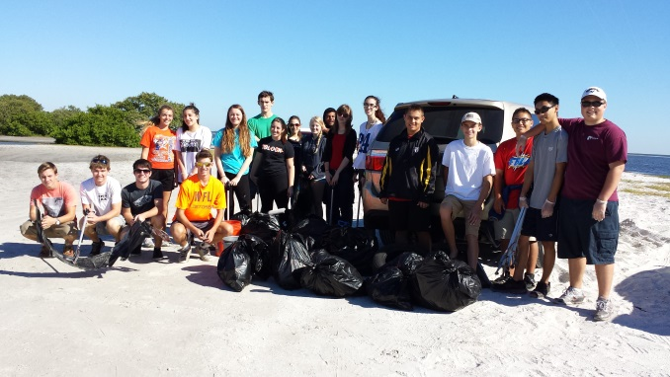
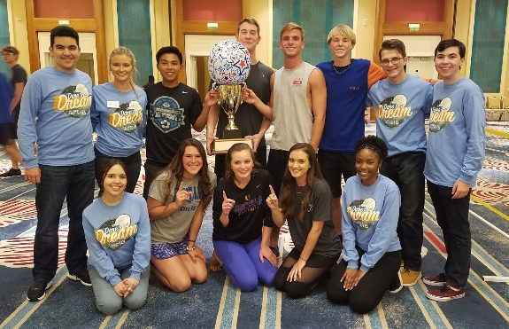
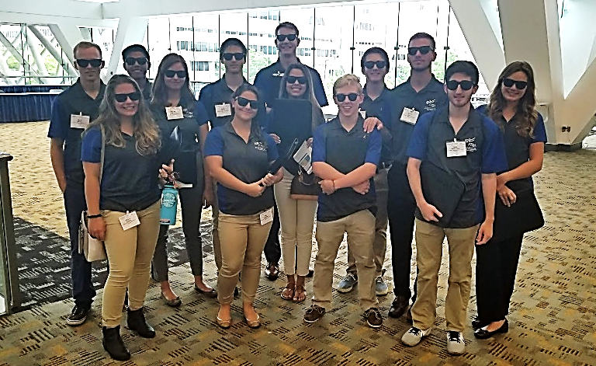
Future Business Leaders of America
Very Active Club
District, State, and National Leadership Conferences & Competitions
Community Service Opportunities
OFHS Annual Golf Tournament
Notes:
Our FBLA is the club our students join as an extension of our programs. Students in FBLA participate in competitions related to their chosen field of interest at the district, state, and national levels. Students also participate in various community service projects and host the Annual Golf Tournament, which by the way we have officially launched for this year – you can sign up today to play on the school website. We are also looking for individuals and business to donate to the tournament, there are many ways you can support our students in FBLA!

Slide 13
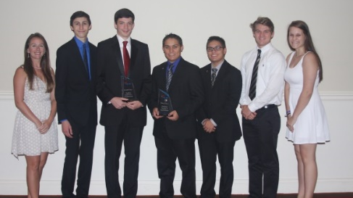
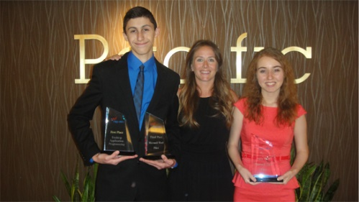
National Winners!
2013 – Anaheim, CA
1st place – Matt Cortez – Desktop Application Programming
3rd Place – Matt Cortez – Microsoft Word Expert
5th Place – Ashley Machie – Microsoft Office Excel
2014 – Nashville, TN
3rd place – Connor Hill – Database Design and Application
7th Place – Sam Rankin – Desktop Application Programming
2015 – Chicago, IL
3rd Place – Connor Hill, Kailey White - Digital Design & Promotion
9th Place – Furkan Memon, Savannah Bedillion, Jonathan Moreno – Digital Video
2018 – Baltimore, MD
2nd place – Mackenzie Moreno – Sales Presentation
3rd Place – AJ Heflin, Wyatt Morris, Adriana Hansen – Web Development
2021 - Virtual
8th – Abby Moore & Kayla Hibberd – Graphic Design
9th – Vega Scholpp – Broadcast Journalism
2022 – Chicago, IL
3rd place – Kayla Dudinsky – Public Service Announcement
9th Place – Nellie Moore – Future Business Leader
Notes:
AS you can see our FBLA has won many awards!

Slide 14
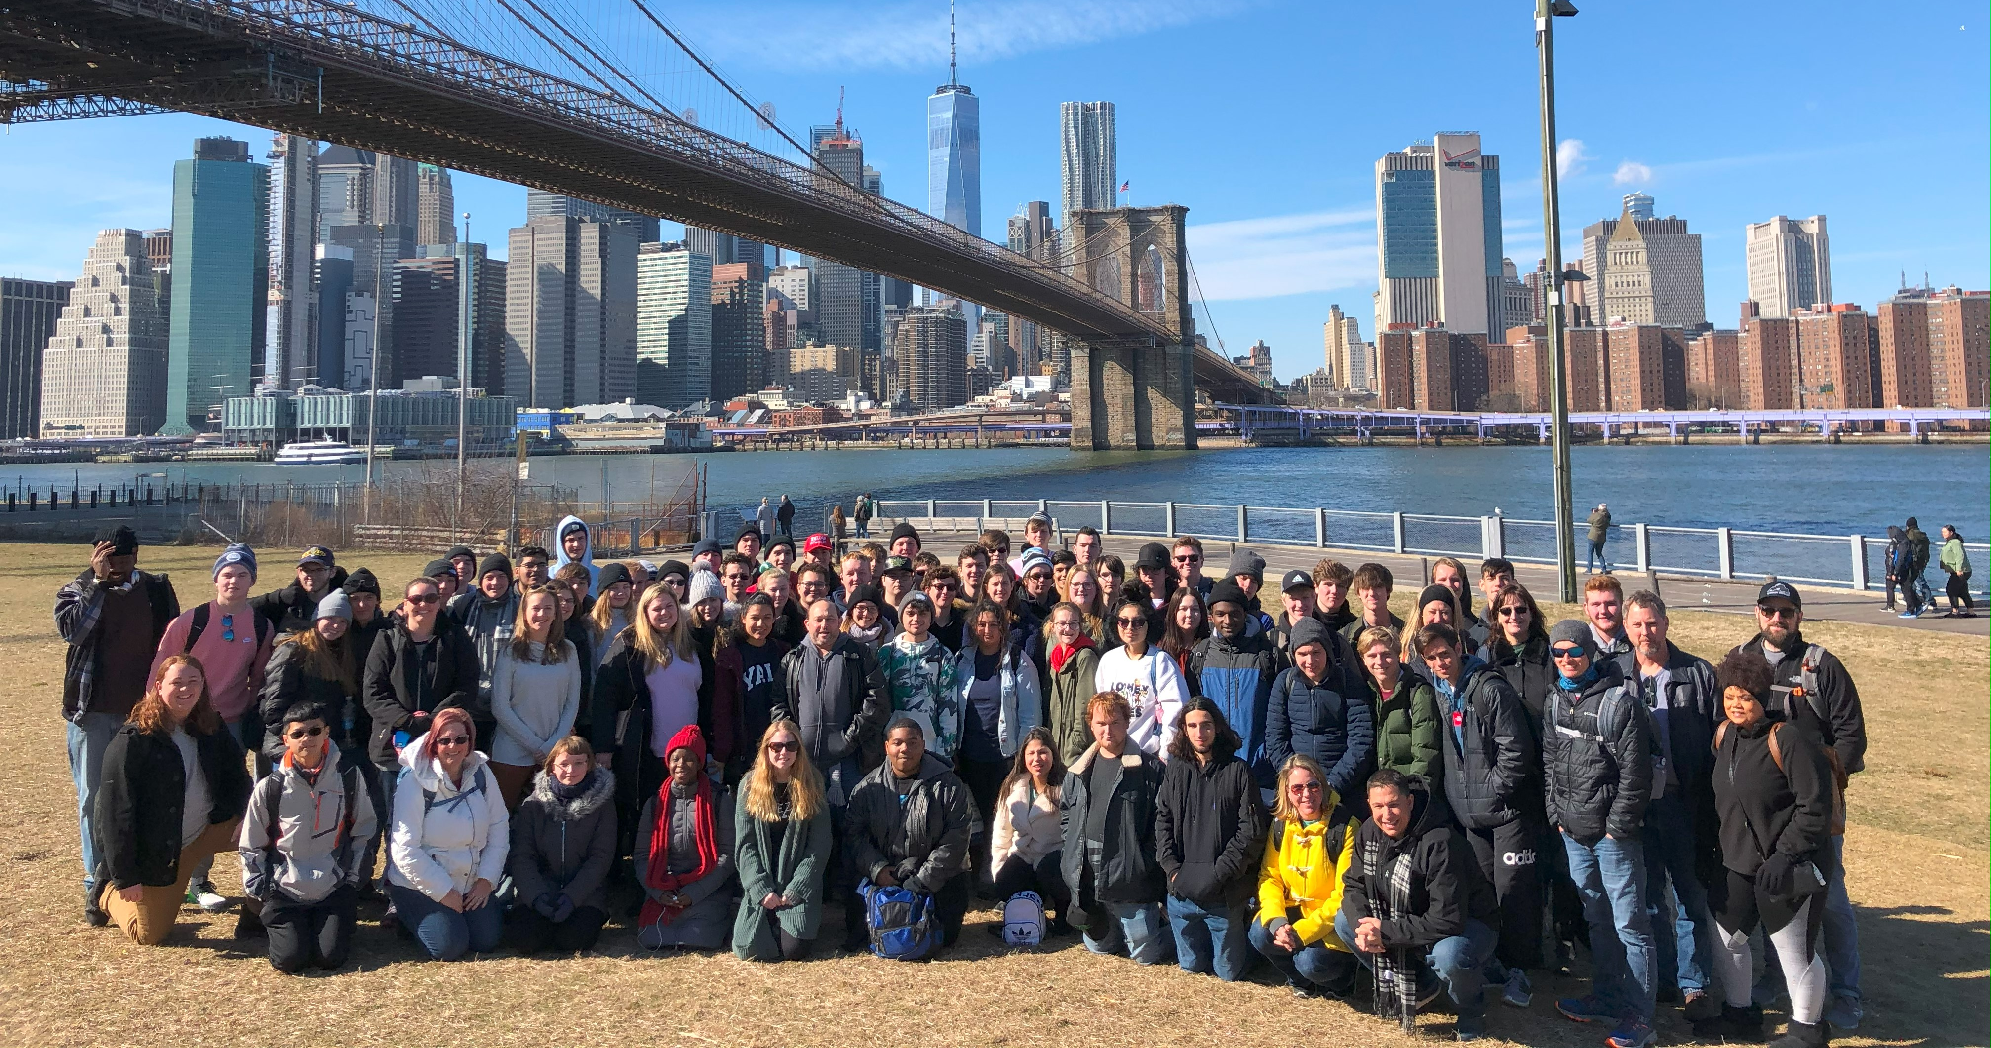
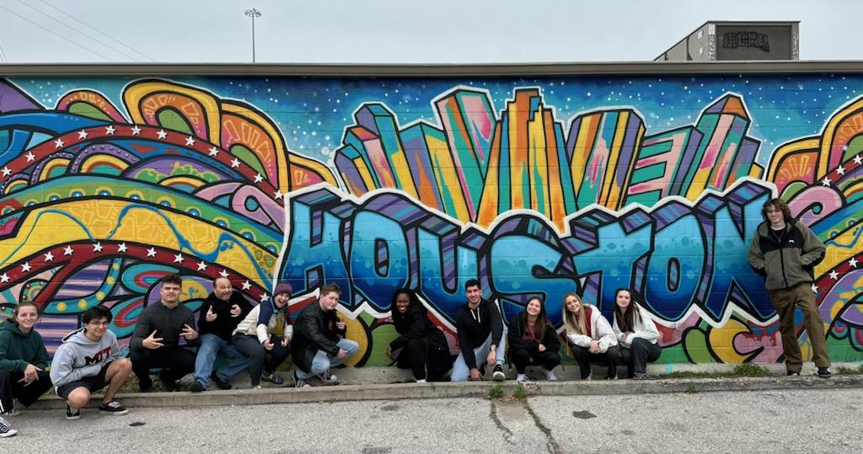
CTED Annual Business Field Trip
Juniors and Seniors in our programs are invited to explore the technology, entrepreneurship, and design industries outside of Florida on our multi-day field trips.
Past visits include:
New York City
Silicon Valley & San Francisco
Austin, Galveston, and Houston
Future Trips:
Spring 2025: NEW YORK CITY
Summer 2026: Portugal??
This Photo by Unknown author is licensed under CC BY-SA.
Notes:
The goal of our yearly field trips are for our students to explore the tech and design industries beyond our local economy. Over the last several years we have explored New York City and Silicon Valley and San Francisco. This past week students visited Texas visiting Houston, Austin, and Galveston where they explored the tech and innovation boom of Austin led by IC Squared which has led a global impact of helping cities around the world develop their economy to attract business and technology. In Houston and Galveston students visited the Space Center and explored a decommissioned Oil Rig where they learned about the space industry and energy & oil and the impact of Texas to the US and global economy.
Next year we will be returning to NYC and are exploring the option of Portugal for 2026. Juniors and Seniors in our programs are invited!

Slide 15
Contact Us
Mr. Jerry Eeten
Eetenje@pcsb.org
Sports Marketing and Entertainment Management
Mr. Jack Mattheus
mattheusw@pcsb.org
Programming
AP Comp Sci
Mrs Amy Loope
loopea@pcsb.org
DIT
Business Management (Entrepreneurship)
FBLA
Mrs. Courtney Thompson
thompsoncou@pcsb.org
DIT
Digital Design
FBLA
Mrs. Debbie Rein Cavagnaro
reind@pcsb.org
Digital Video Production
OJT/DCT

